Slide 1
Nuclease Assays
Main text

Slide 2
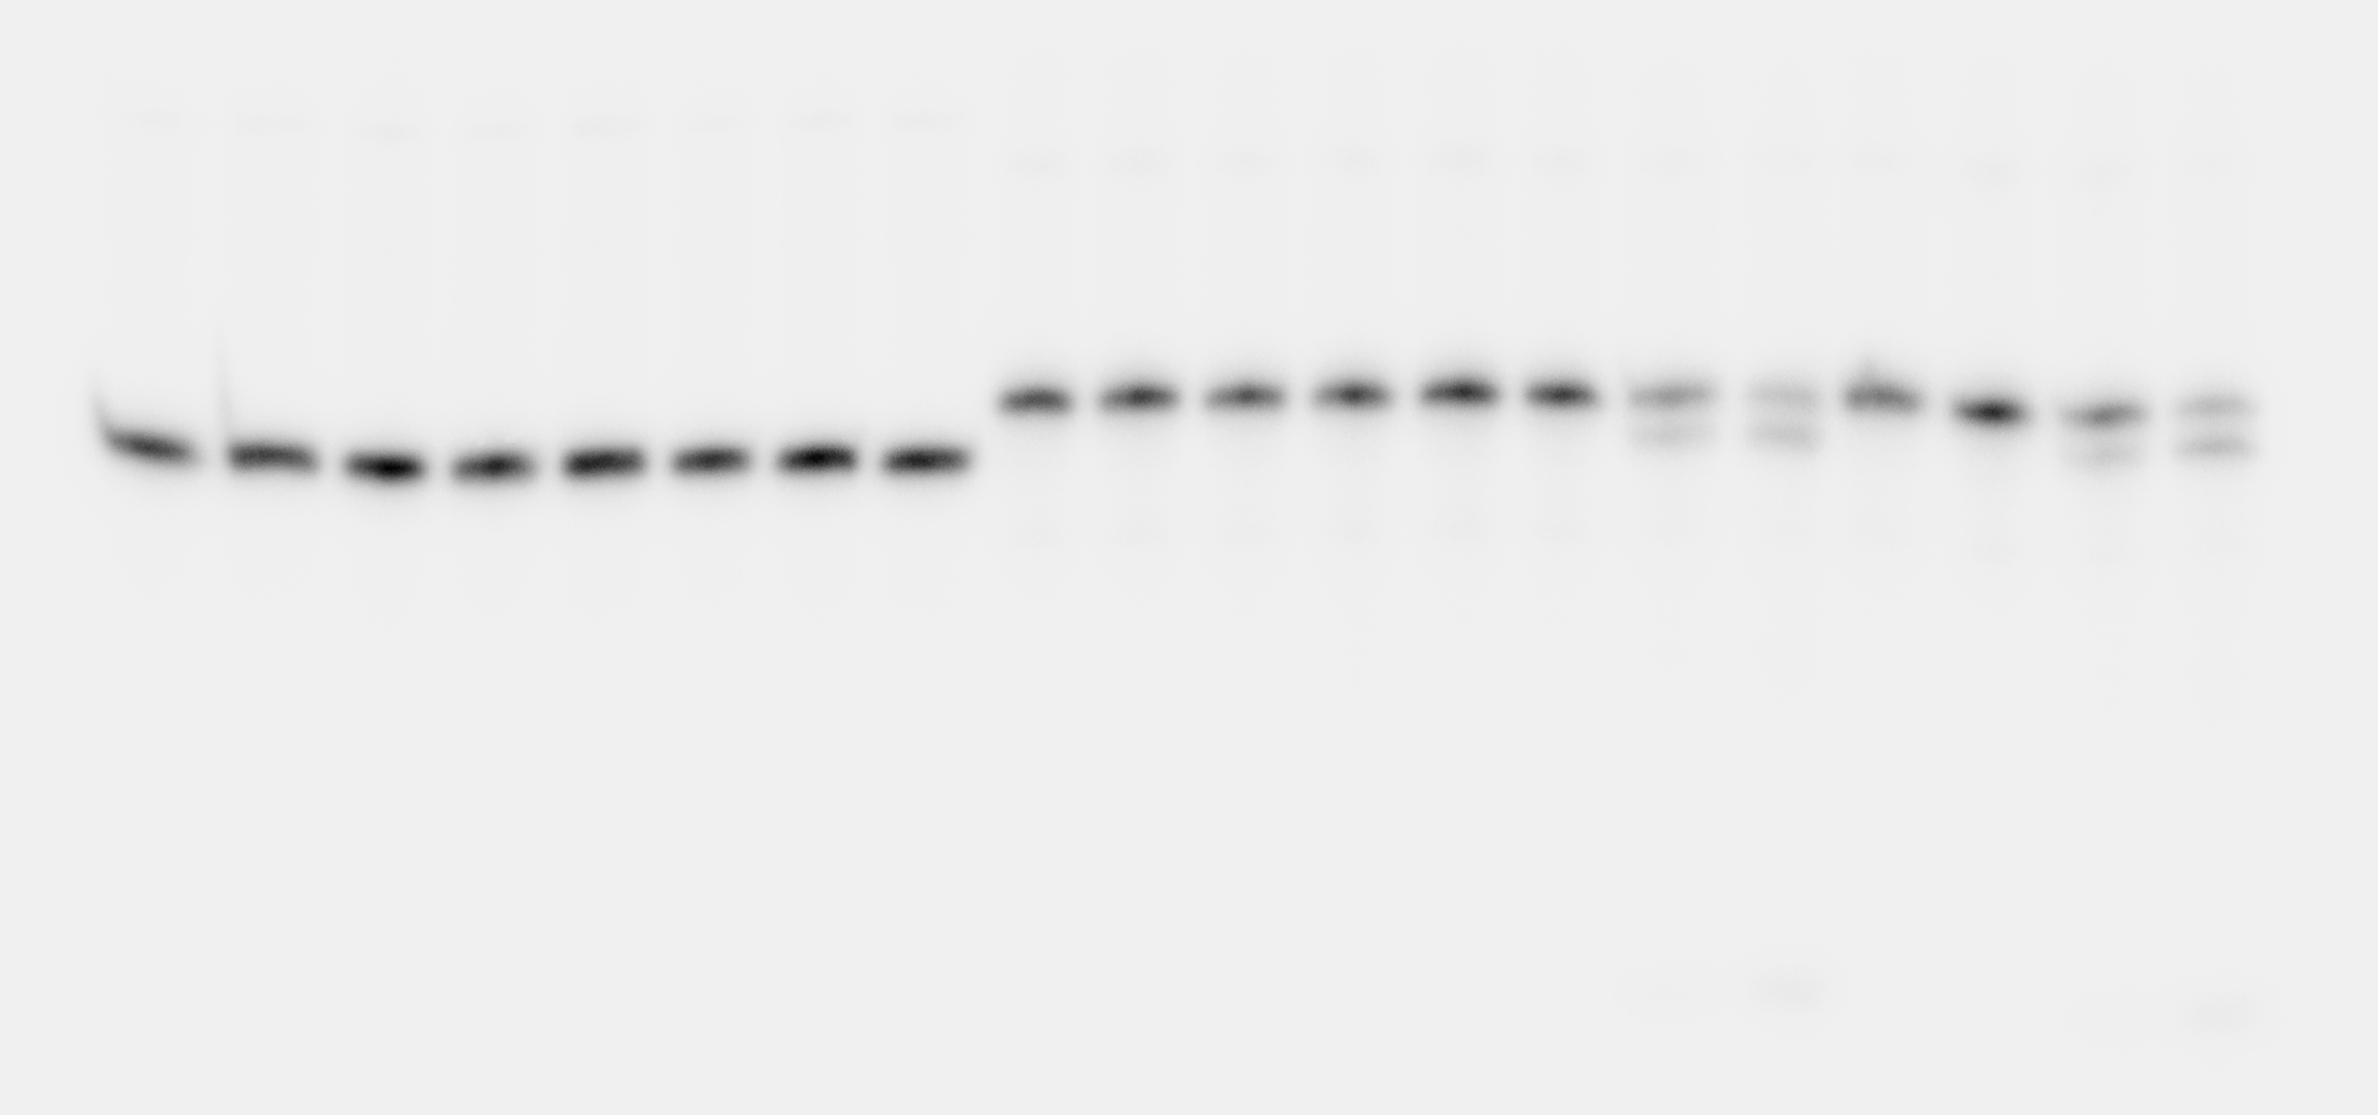
Fig. 2A
ssDNA
dsDNA
ssRNA
dsRNA
RNA*-DNA
5’
5’
5’
5’
5’
0 500 0 500 0 500 0 500 0 500 nM CDIN1
Radiolabelled

Slide 3
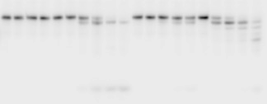
Fig. 3D
ssRNA
RNA*-DNA
5’
5’
CDIN1
CDIN1-Codanin-1
CDIN1
CDIN1-Codanin-1
0 500 0 500 0 500 0 500 nM
Radiolabelled

Slide 4
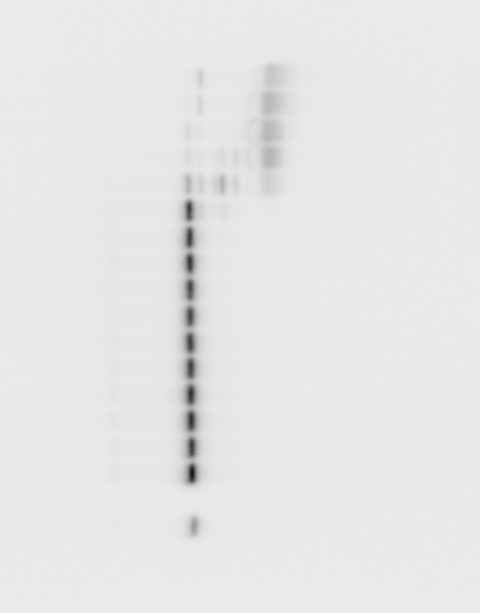
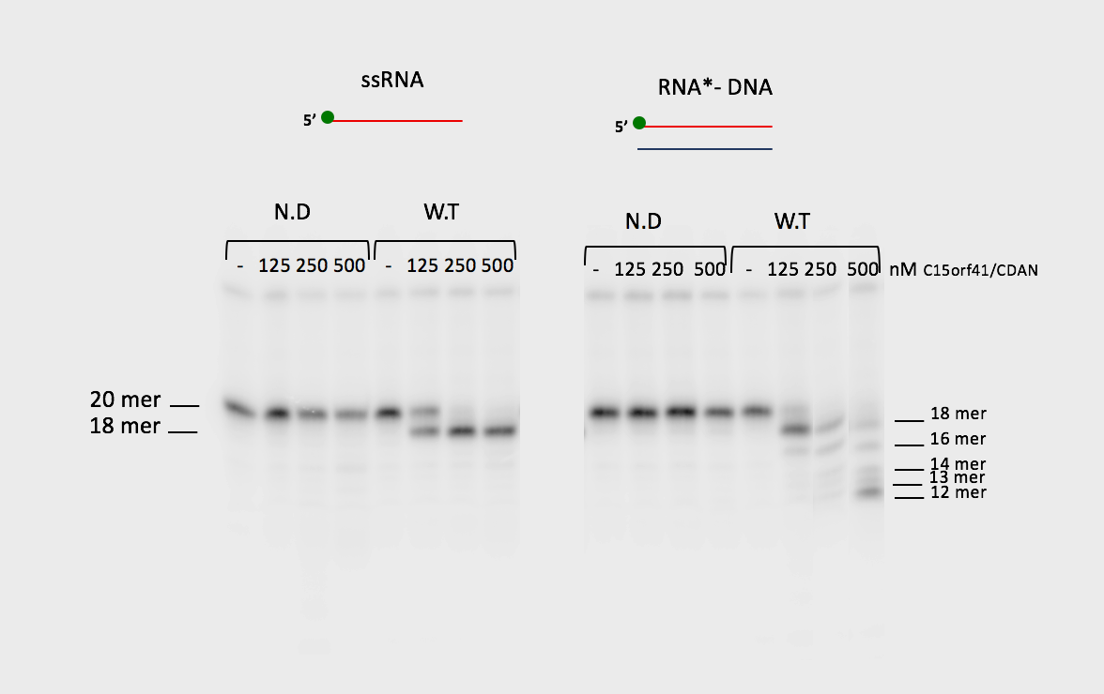
Fig. 4A
RNA*-DNA
5’
CDIN1^{D196A,E214A}-
Codanin-1
CDIN1
0 500 0 500
RNA*-DNA
5’
Codanin-1
CDIN1-Codanin-1
0 500 0 500 nM
Radiolabelled

Slide 5
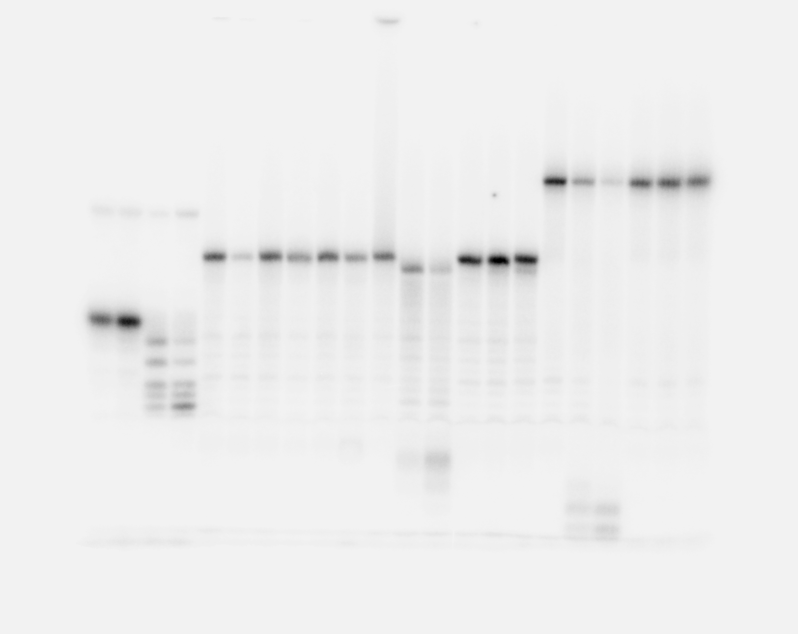
Fig. 4A
Radiolabelled

Slide 6
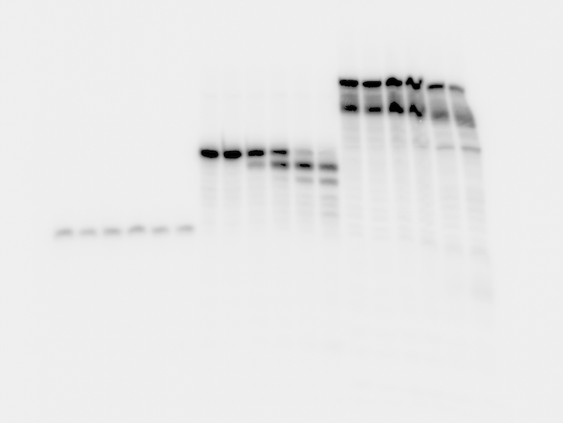
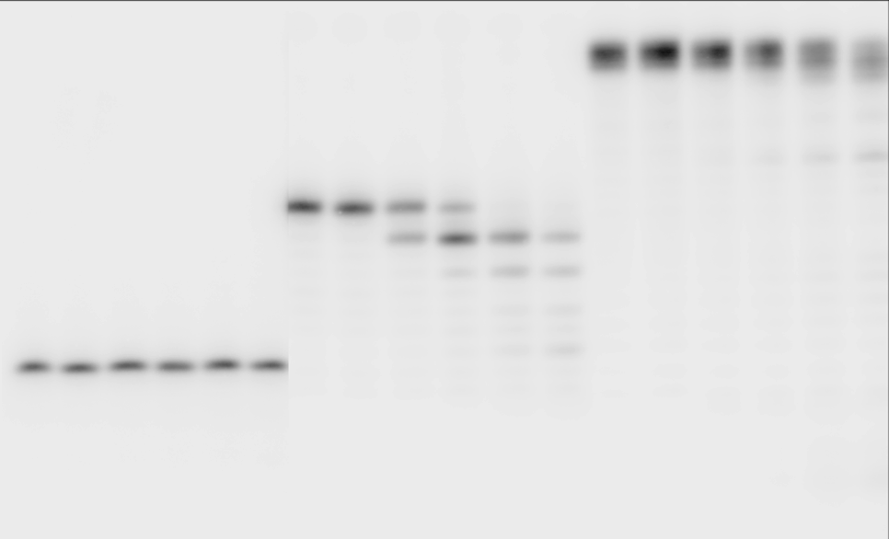
Fig. 4D
RNA*-DNA
RNA*-DNA
5’
5’
RNA*-DNA
5’
0 500 nM CDIN1-Codanin-1
0 500 0 500 nM CDIN1-Codanin-1
30mer
30mer
20mer
20mer
10mer
Radiolabelled

Slide 7
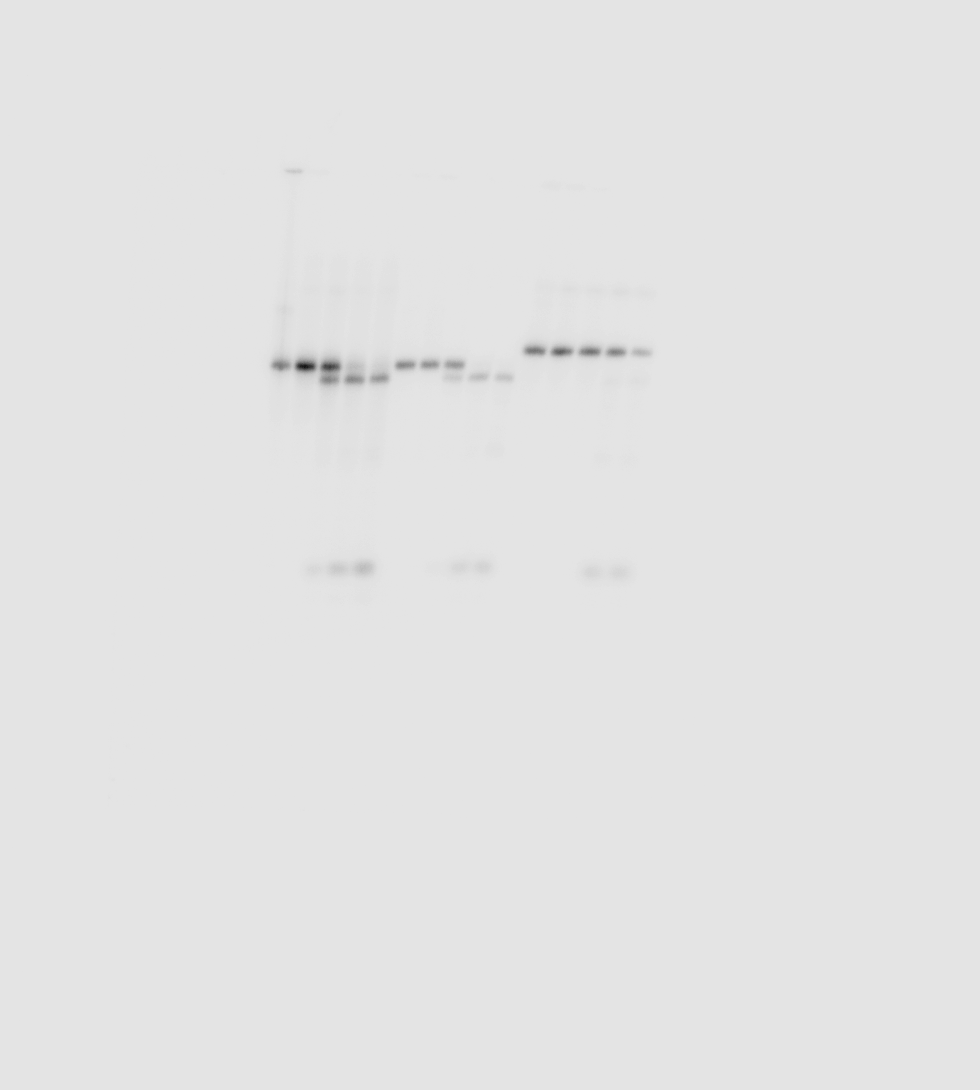
Fig. 4F
Radiolabelled

Slide 8
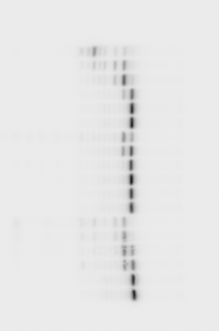
Fig. 6A
RNA*-DNA
5’
CDIN1^{Y94C}-Codanin-1
CDIN1^{L178Q}-Codanin-1
0 500 0 500 nM
Radiolabelled

Slide 9
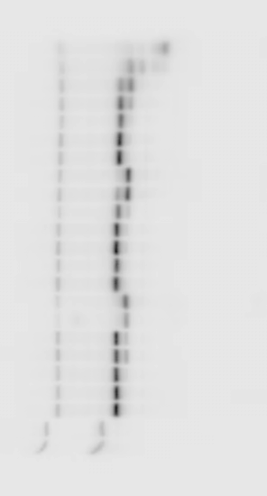
Fig. 6A
RNA*-DNA
5’
CDIN1-Codanin-1
0 500 nM
Radiolabelled

Slide 10
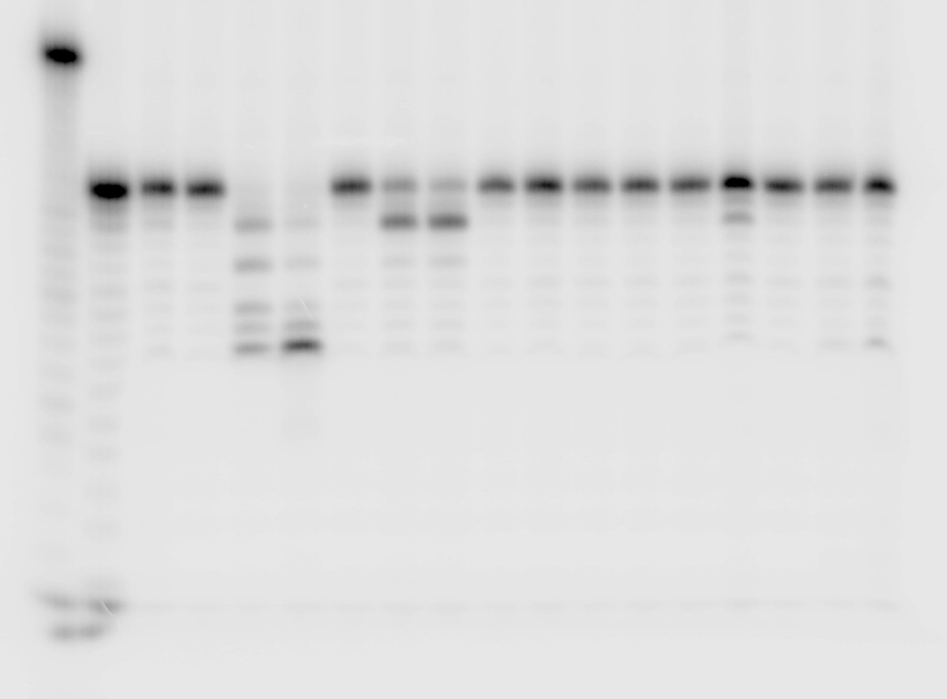
Fig. 6B
RNA*-DNA
5’
CDIN1-Codanin-1
CDIN1
CDIN1^{Y94C}
CDIN1^{L178Q}
0 500 0 500 0 500 0 500 nM
Radiolabelled

